Slide 1
Chapter 12 Arrays Continued
Fundamentals of Java: AP Computer Science Essentials, 4th Edition
Lambert / Osborne

Slide 2
Objectives
Write a method for searching an array
Write a method for sorting an array
Write methods to perform insertions and removals at given positions in an array
Create and manipulate two-dimensional arrays
‹#›
‹#›

Slide 3
Vocabulary
binary search
bubble sort
insertion sort
linear search
multidimensional array
one-dimensional array
ragged array
selection sort
two-dimensional array
‹#›
‹#›

Slide 4
Searching
Searching collections of elements for a target element is a common software operation.
Linear Search:
A linear search examines each element in a sequence.
Starts with the first.
Loop breaks if the target is found.
‹#›
‹#›

Slide 5
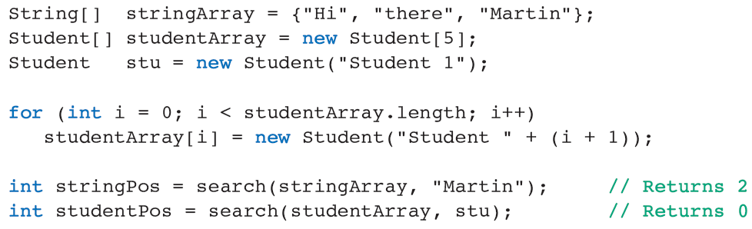
Searching (continued)
Searching an Array of Objects:
‹#›
‹#›

Slide 6
Searching (continued)
Binary Search:
A binary search examines the element at an array’s midpoint on each pass through the search loop.
If the current element matches the target, we return its position.
If the current element is less than the target, we search to the right; otherwise, to the left.
‹#›
‹#›

Slide 7
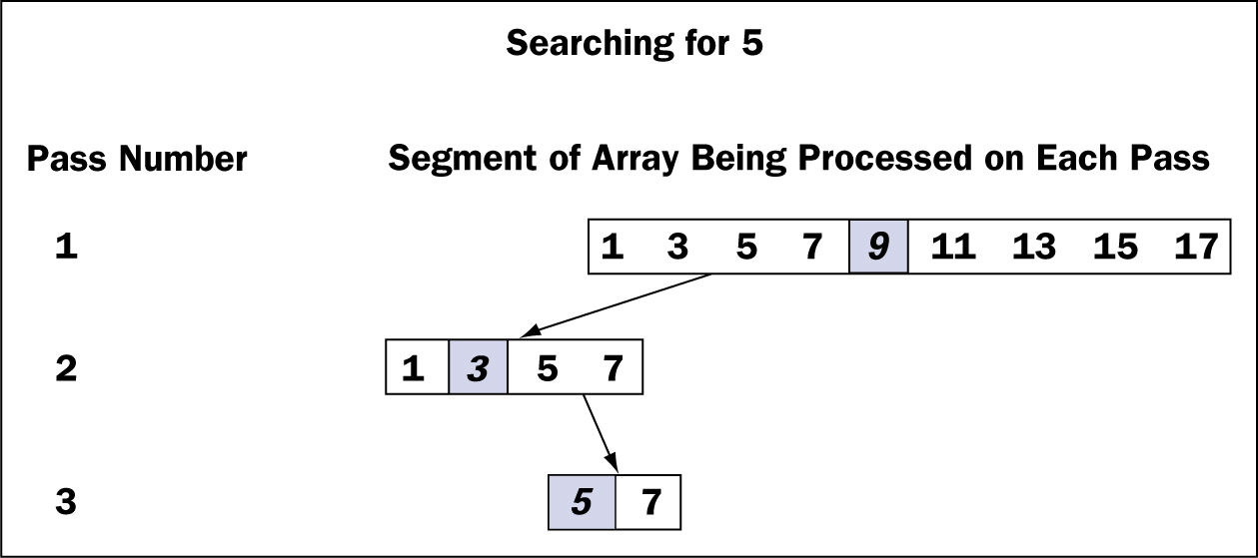
Searching (continued)
Binary Search (cont):
A trace of a binary search of an array
‹#›
‹#›

Slide 8
Searching (continued)
Comparing Objects and the Comparable Interface:
When using binary search with an array of objects, we must compare two objects.
<, >, and == are not good choices.
The Comparable interface includes the method compareTo.
‹#›
‹#›

Slide 9
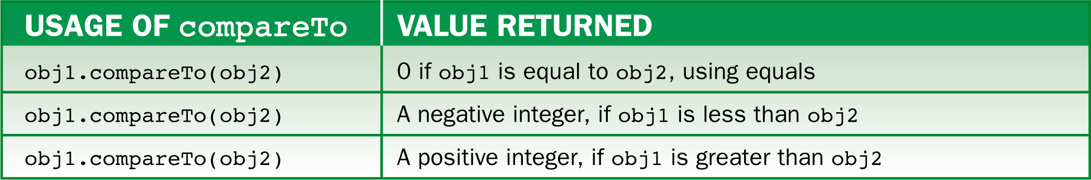
Searching (continued)
Comparing Objects and the Comparable Interface (cont):
Before sending the compareTo message, the object must be cast to Comparable.
Object does not implement the Comparable interface or include a compareTo method.
‹#›
‹#›

Slide 10
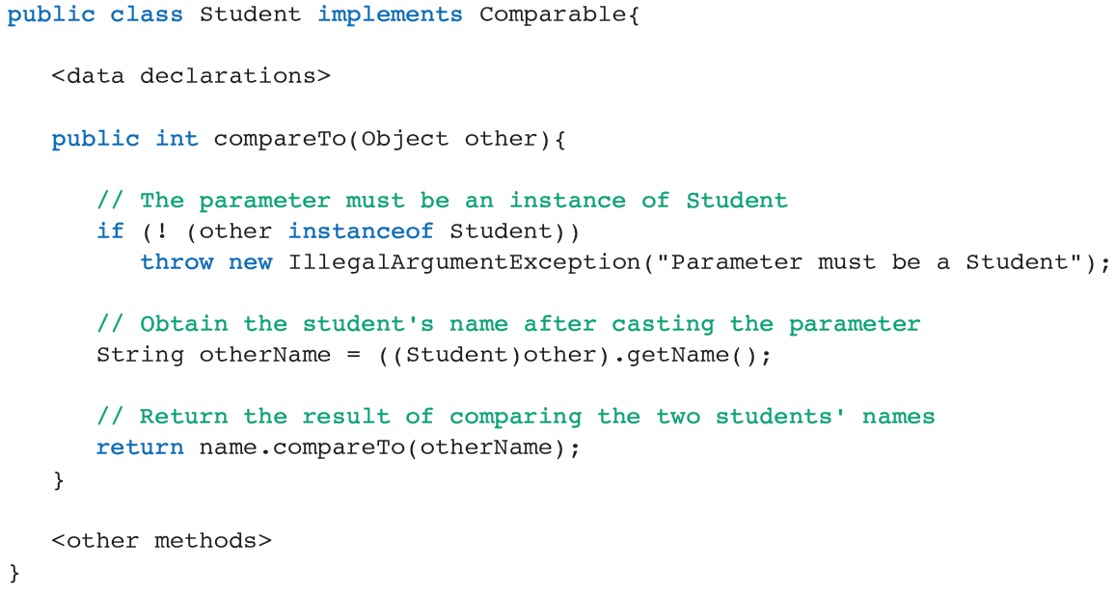
Searching (continued)
Implementing the Method compareTo:
‹#›
‹#›

Slide 11
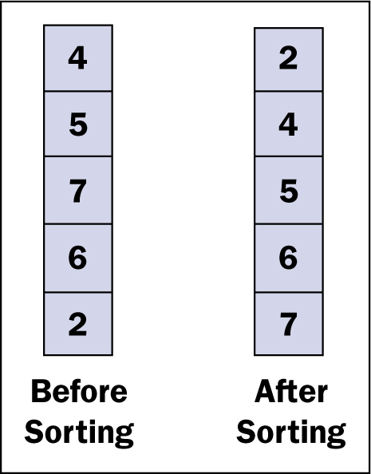
Sorting
Sorting: arranging the elements in an array in an order.
An array before and after sorting
‹#›
‹#›

Slide 12
Sorting (continued)
Selection Sort:
For each index position i
Find the smallest data value in the array from positions i through length -1, where length is the number of values stored.
Exchange the smallest value with the value at position i.
‹#›
‹#›

Slide 13
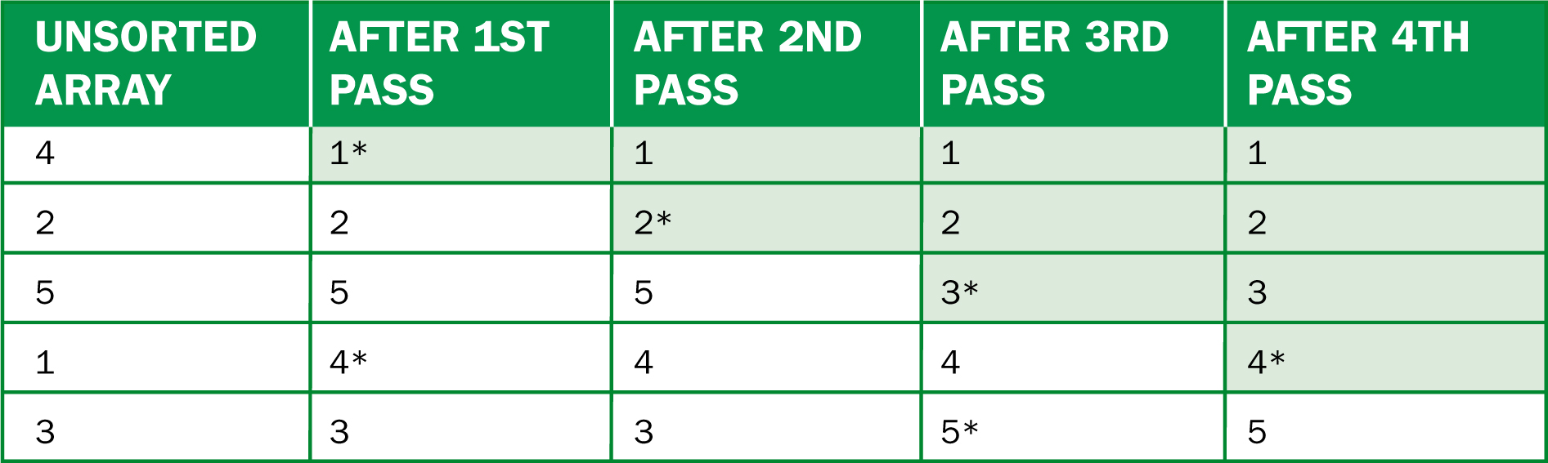
Sorting (continued)
Selection Sort (cont):
A trace of the data during a selection sort
‹#›
‹#›

Slide 14
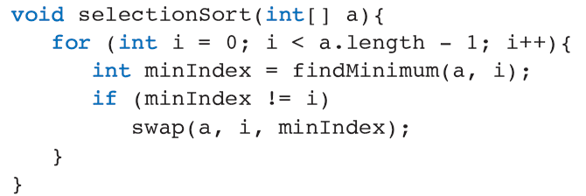
Sorting (continued)
Selection Sort (cont):
Before writing a selection sort algorithm:
If the array is of length n, we need n-1 steps.
We must be able to find the smallest number.
We need to exchange appropriate array items.
‹#›
‹#›

Slide 15
Sorting (continued)
Bubble Sort:
A bubble sort causes a pass through the array to compare adjacent pairs of items.
When two items are out of order with respect to each other, they are swapped.
‹#›
‹#›

Slide 16
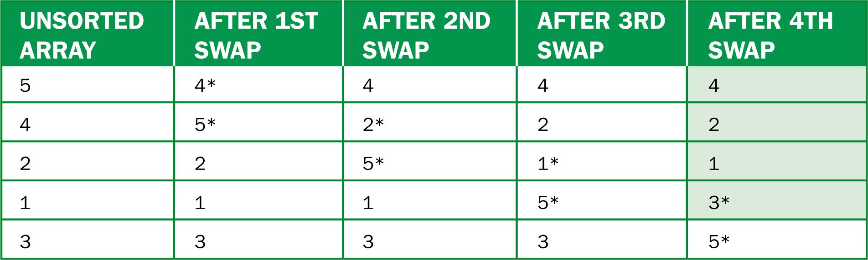
Sorting (continued)
Bubble Sort (cont):
A trace of the data during a pass of a bubble sort
Swapped items have an asterisk (*)
‹#›
‹#›

Slide 17
Sorting (continued)
Bubble Sort (cont):
The bubble sort algorithm uses a nested loop.
The outer loop controls the number of successively smaller passes through the array.
The inner loop controls the pairs of adjacent items being compared.
If a pass is made through the inner loop without a swap, the array is sorted.
For a loop that is nearly ordered, use a bubble sort for efficiency.
‹#›
‹#›

Slide 18
Sorting (continued)
Insertion Sort:
The insertion sort takes advantage of an array’s partial ordering.
The goal is that on the kth pass, the kth item among a[0],a[1],…a[k] is inserted into its rightful place among the first k items in the array.
‹#›
‹#›

Slide 19
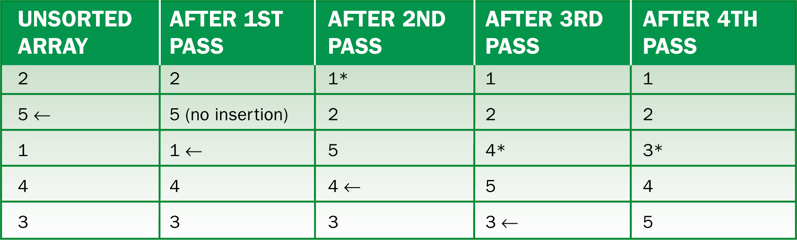
Sorting (continued)
Insertion Sort (cont):
A trace of the data during an insertion sort.
Data items are sorted relative to each other above the asterisked (*) item.
‹#›
‹#›

Slide 20
Sorting (continued)
Sorting Arrays of Objects:
Any sort method can sort arrays of objects.
Assume that the objects implement the Comparable interface and support the method compareTo.
Then, replace the element type of all array parameters with Object and use compareTo.
‹#›
‹#›

Slide 21
Sorting (continued)
Testing Sort Algorithms:
Each sort method and its helper methods should be defined as private static.
You should test methods with an array that has already been sorted as well.
‹#›
‹#›

Slide 22
Insertions and Removals
Four assumptions when adding or removing elements to arbitrary positions in an array:
Arrays are fixed size; a full array cannot be added to.
We are working with an array of objects, although any element type could be used.
For insertions: 0 <= target index <= logical size.
The new element is inserted at the target index, or after the last elements if the target index equals the logical size.
For removals: 0 <= target index < logical size.
‹#›
‹#›

Slide 23
Insertions and Removals (continued)
Inserting an Item into an Array at an Arbitrary Position:
Check for available space and validity of target index, or return false.
Shift items from logical end of array to target index down by one position.
Assign a new item to the cell at the target index.
Increment the logical size by one.
Return true.
‹#›
‹#›

Slide 24
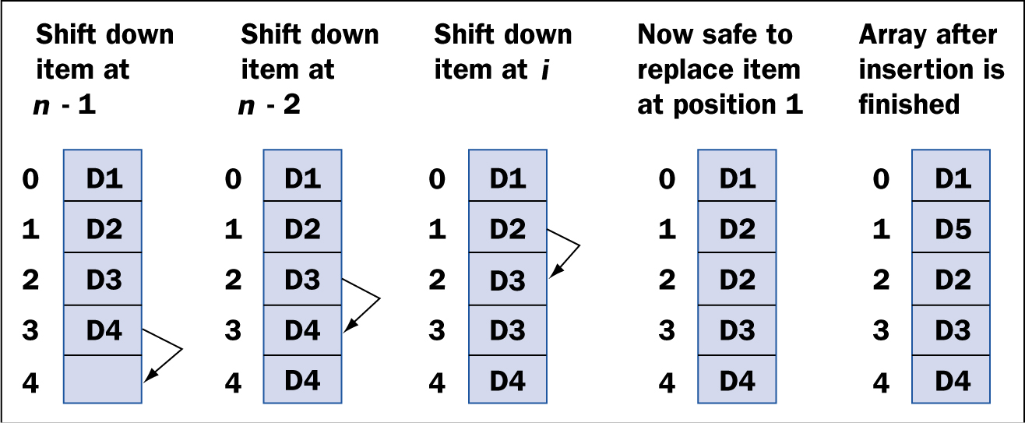
Insertions and Removals (continued)
Inserting an Item into an Array at an Arbitrary Position (cont):
Inserting an item into an array
‹#›
‹#›

Slide 25
Insertions and Removals (continued)
Removing an Item from an Array:
Check validity of target index, or return false.
Shift items from target index to logical end of array up by one position.
Decrement the logical size by one.
Return true.
‹#›
‹#›

Slide 26
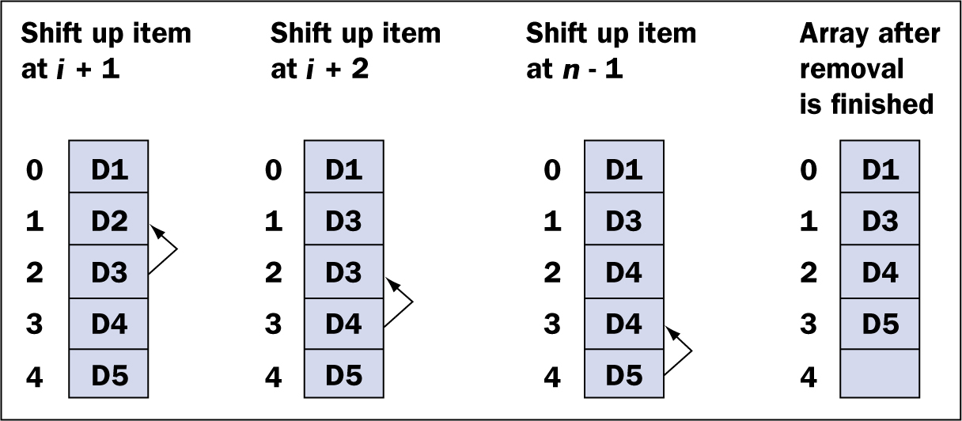
Insertions and Removals (continued)
Removing an Item from an Array (cont):
Removing an item from an array
‹#›
‹#›

Slide 27
Insertions and Removals (continued)
A Tester Program for Array Methods:
Example: specifying two methods in the context of a tester program.
Method insertItem expects the array, its logical size, target index, and new item as parameters.
The client must check the Boolean value to take proper action, such as increment the logical size.
‹#›
‹#›

Slide 28
Two-Dimensional Arrays
One-dimensional array: a simple list of items.
Multidimensional array: multiple lists of items.
Two-dimensional array: i.e. a table of numbers.
To specify that the value in row 2, column 3 is 23:
‹#›
‹#›

Slide 29
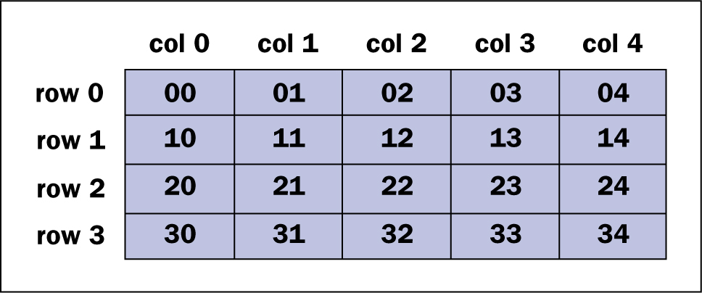
Two-Dimensional Arrays (continued)
A two-dimensional array with four rows and five columns
‹#›
‹#›

Slide 30
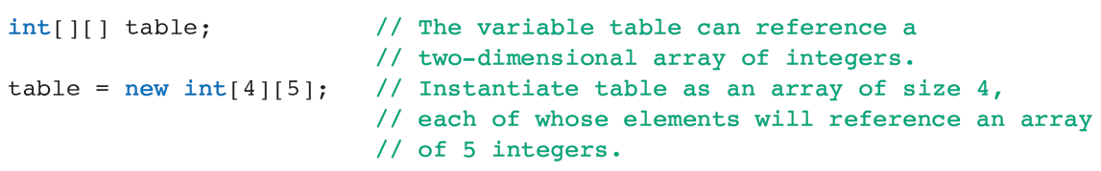
Two-Dimensional Arrays (continued)
Two-dimensional arrays can be used to sum rows or columns.
Declare and Instantiate:
‹#›
‹#›

Slide 31
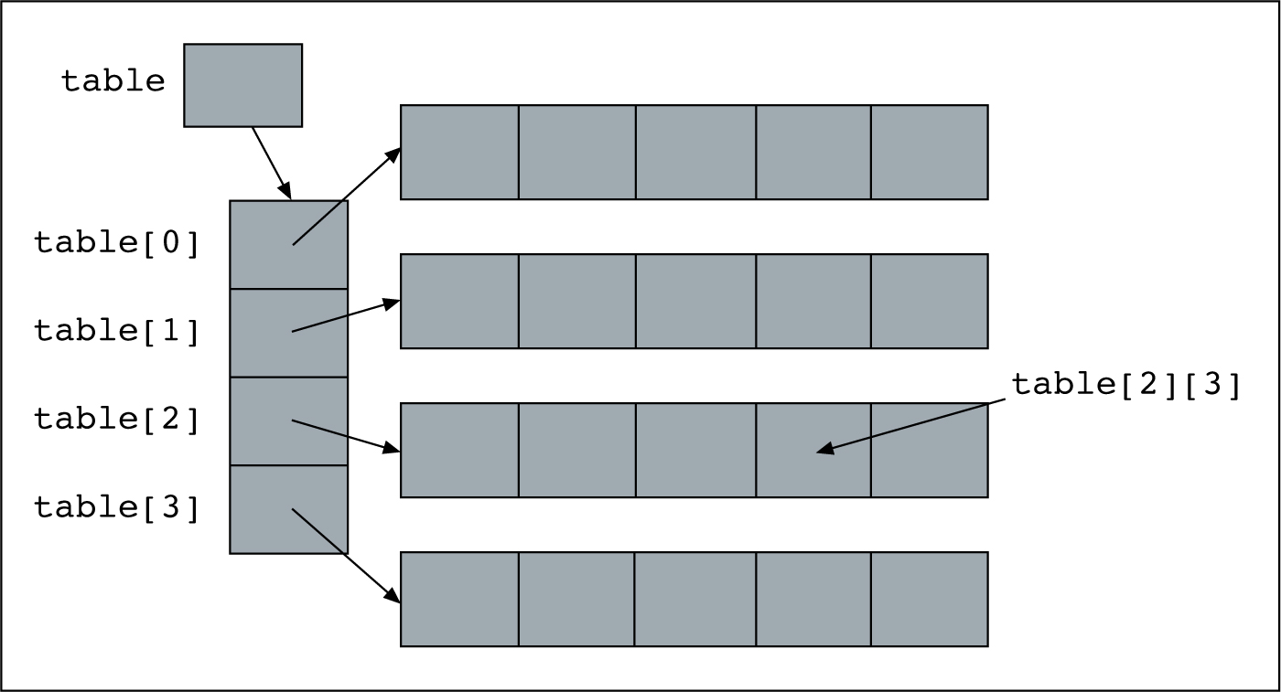
Two-Dimensional Arrays (continued)
Declare and Instantiate (cont):
Another way of visualizing a two-dimensional array
‹#›
‹#›

Slide 32
Two-Dimensional Arrays (continued)
Declare and Instantiate (cont):
Initializer lists can be used with two-dimensional arrays.
Use a list of lists.
Variable Length Rows:
Ragged array: when the rows of a two-dimensional array are not the same length.
All the elements of a two-dimensional array must be of the same type.
‹#›
‹#›

Slide 33
Applications of Two-Dimensional Arrays
Two-dimensional arrays are most useful for representing data in a two-dimensional grid.
The Game of Tic-Tac-Toe:
Game board is an object that allows the user to:
View the state of the game in two-dimensions.
Place X or O.
Determine if game has been won/board is full.
Reset board.
‹#›
‹#›

Slide 34
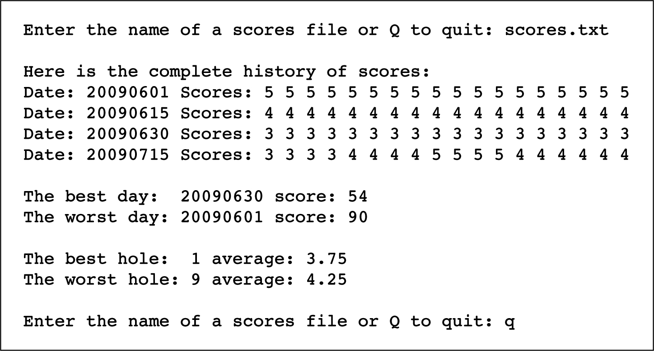
Applications of Two-Dimensional Arrays (continued)
Tracking Golf Scores:
Sample session of golf program
‹#›
‹#›

Slide 35
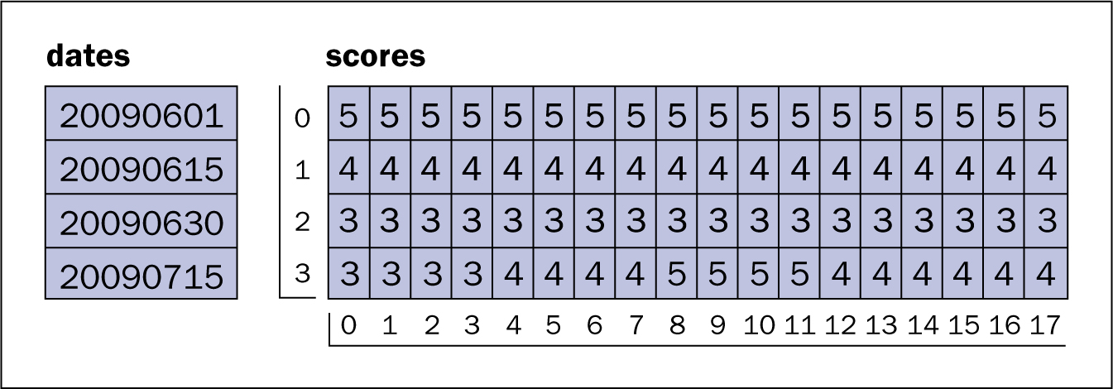
Applications of Two-Dimensional Arrays (continued)
Tracking Golf Scores (cont):
The GolfScoreCard class represents a card as two arrays.
First contains the dates from the input file.
Second is a two-dimensional array (rounds, scores).
The two arrays for the golf scores tracking program
‹#›
‹#›

Slide 36
Graphics and GUIs: Menus
Example: adding drop-down menus to a GUI.
Menu bar, menus, and menu selections.
Create a menu item object for each menu item, a menu object for each menu, and a menu bar object in which all menu objects will appear.
Menu items emit action events when selected.
Attach action listeners for tasks to the menu items.
‹#›
‹#›

Slide 37
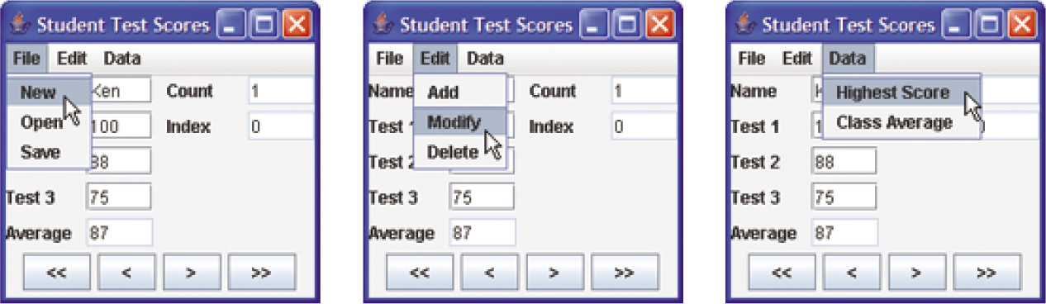
Graphics and GUIs: Menus (continued)
The new user interface for the student test scores program
‹#›
‹#›

Slide 38
Summary
In this chapter, you learned:
A linear search is a simple search method that works well for small- and medium-sized arrays.
A binary search is a clever search method that works well for large arrays but assumes that the elements are sorted.
‹#›
‹#›

Slide 39
Summary (continued)
Comparisons of objects are accomplished by implementing the Comparable interface, which requires the compareTo method.
Selection sort, bubble sort, and insertion sort are simple sort methods that work well for small- and medium-sized arrays.
‹#›
‹#›

Slide 40
Summary (continued)
Insertions and removals of elements at arbitrary positions are complex operations that require careful design and implementation.
Two-dimensional arrays store values in a row-and-column arrangement similar to a table.
‹#›
‹#›

